Slide 1
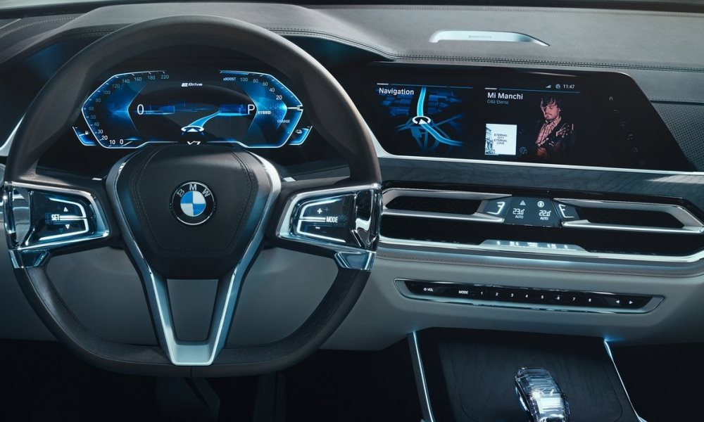
Infrastructure for BMW Test Car Display System
Project A – Spring 2018
By: Vivian Lawin & Daher Daher High Speed Digital Systems Lab (HSDSL)
Supervisor: Boaz Mizrachi Technion – Israel Institute of Technology

Slide 2
Motivation
Enhance the driving experience in BMW cars in general (and BMW’s Autonomous cars in particular).
Not only feel the condition of the environment and traffic, but also the condition of the road.
- Fraction
- Humidity
- Temperature
- Angle, etc…

Slide 3
Goals
Analyze the Real-Time data collected by the car’s sensors.
Provide a rich and elegant UI to graphically display the data.

Slide 4
Functionality Requirements
Inputs:
Data stream of the conditions we are checking.
The conditions user wants to be displayed each time (up to 4).
Behavior:
Analyze the data collected by the car’s sensors according to the user’s input.
Outputs:
Graphs showing the real time data for the specified conditions.

Slide 5
Functionality Block Diagram
Graph Viewer
Fraction Analyzer Block
Humidity Analyzer Block
Temp Analyzer Block
Angle Analyzer Block
Weight Analyzer Block
Stability Analyzer Block
Wi-Fi
Data
Streams
Server

Slide 6
Screens and Displays
Device: GINI Tab V7 May change
Operating System – Android Nougat 7
- 22.9% of all android users
Screen size: 7”
Screen resolution: 1280x800

Slide 7


Development Tools
Android Studio IDE 3.3
- Java over Windows OS
Adobe Photoshop CC 2015
Adobe Illustrator CC 2015

Slide 8

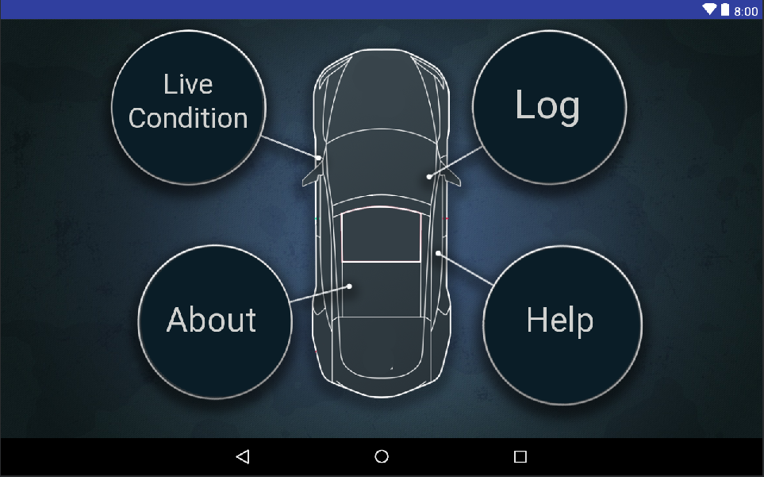
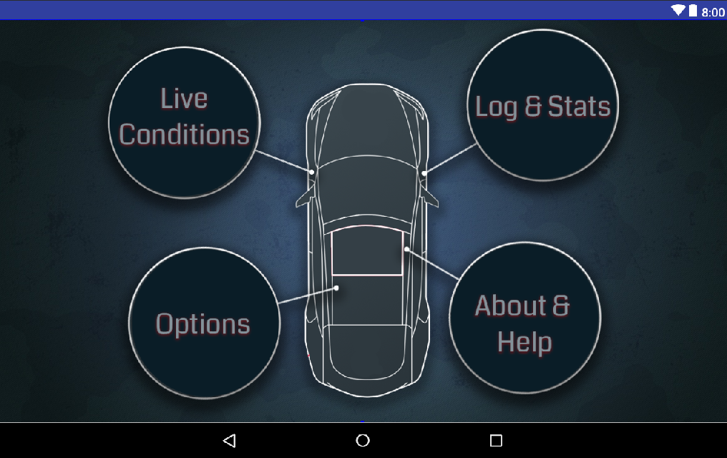
GUI Design

Slide 9
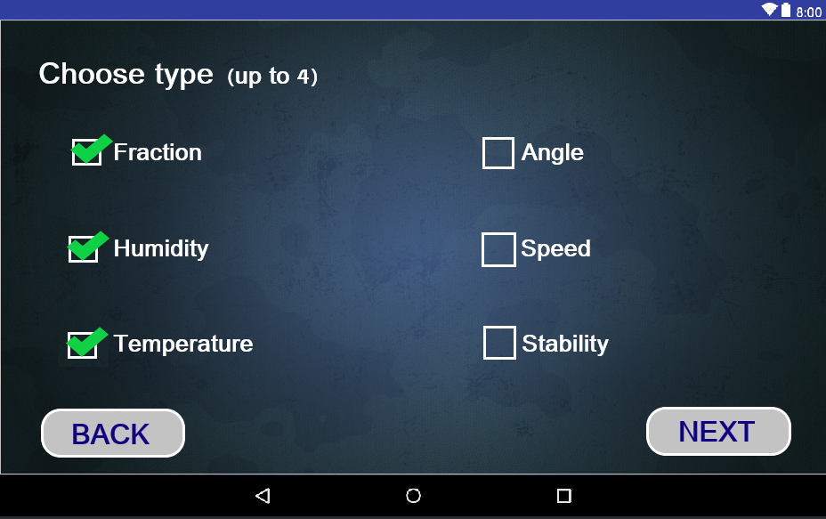


GUI Design Type

Slide 10
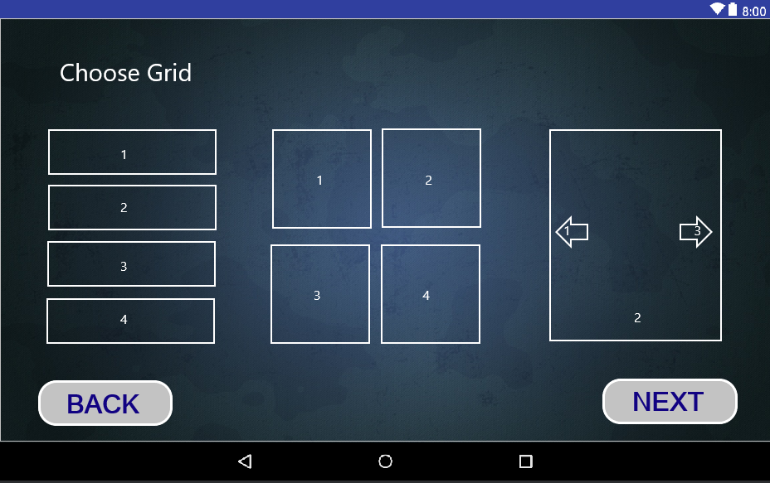

GUI Design Grid

Slide 11
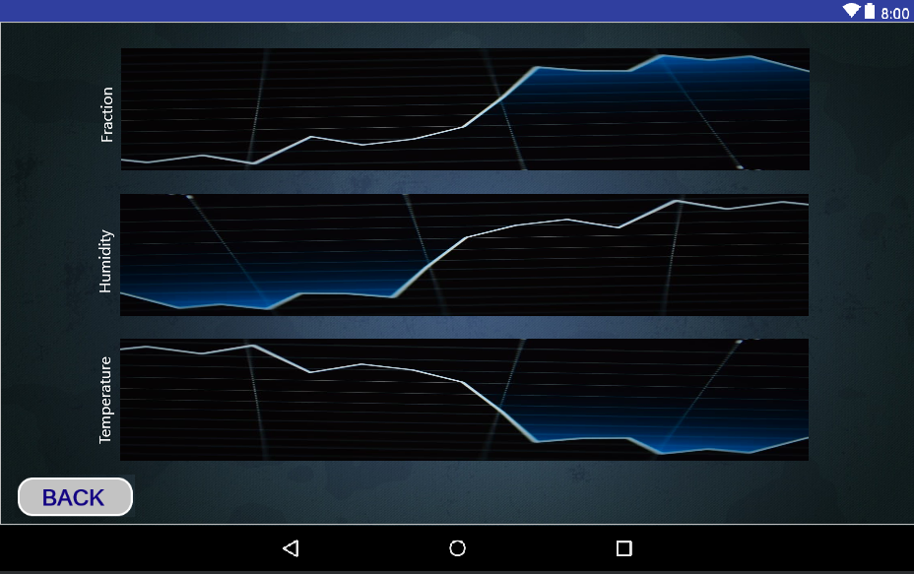

GUI Design Data

Slide 12
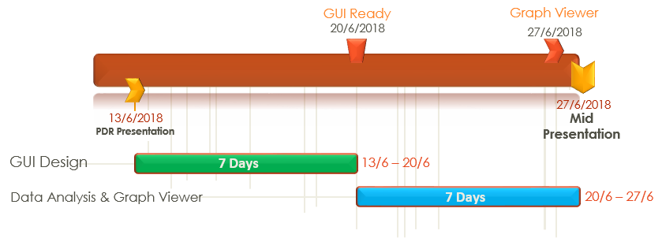
Gantt Chart

Slide 13
What’s Next?

